Slide 1
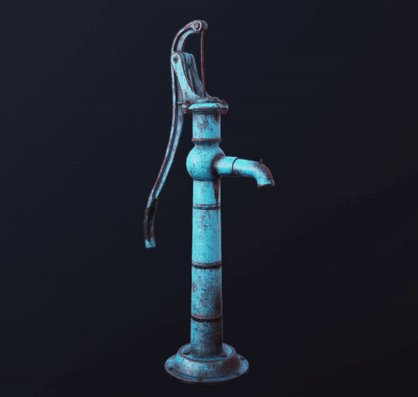
Pump it Up
Data Mining the Water Table
Team Chernoff:
Jenny Oh, Shitangshu Maity, Isaac Ng, Jiamin Mei,
Wendy Fang, Akshay Malhotra, Lily Keramati, Leon Joulakian

Slide 2



Background
4 million
29 million
70% of health budget
Lack access to safe water
Don’t have access to improved sanitation
Spent on preventable water related diseases

Slide 3
Data Cleaning & Feature Engineering
Technique | Features
Data exploration | All
Fixing typo | Installer, Funder
Missing value imputation | Longitude, Latitude, gps_height, etc.
Feature selection from related features | Source – Source Type – Source Class; management – management group; etc.
Binning | Construction year
Create new features | Permit, Water quality ind.,
Correlation | All
Log transformation | Population
Ordinal encoding | All categorical features
Balancing data

Slide 4
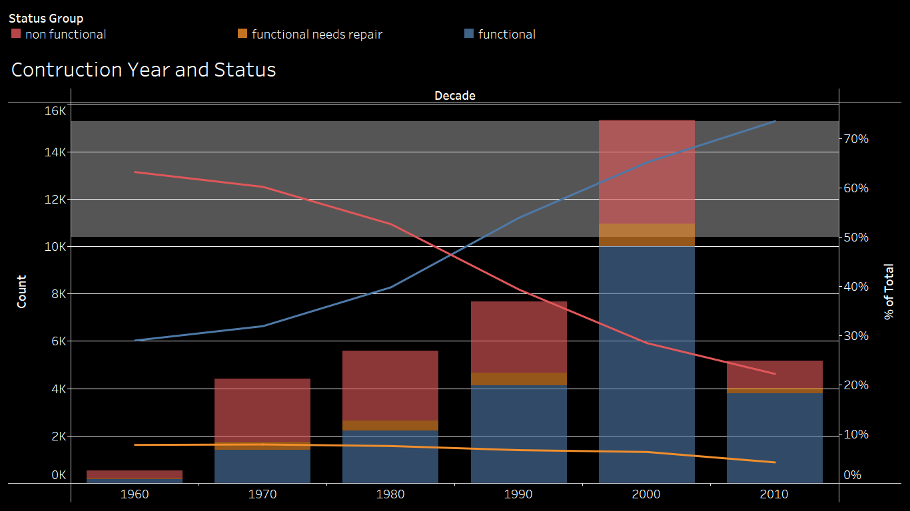
Data Exploration
Construction year of 1990’s or before had 50% or more of non-functional water pumps
Binning of Construction Year’s was done for every 10 year interval

Slide 5
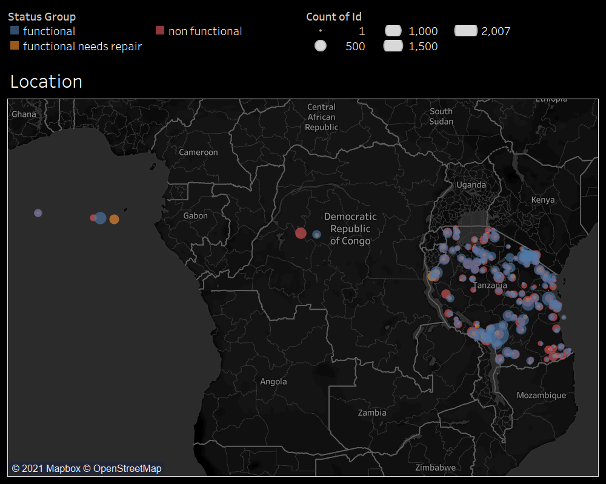
Data Exploration
“0” values in longitude and latitude were identified and treated as missing values
Missing values imputed using relation to their other location indicators such as sub-village and local government area

Slide 6
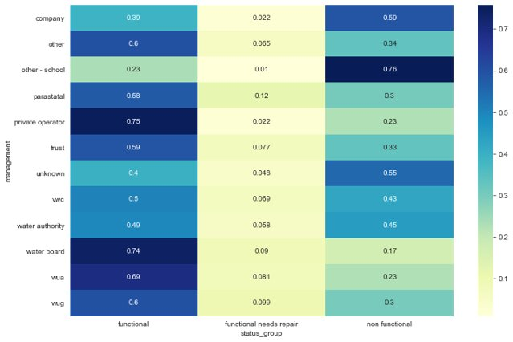
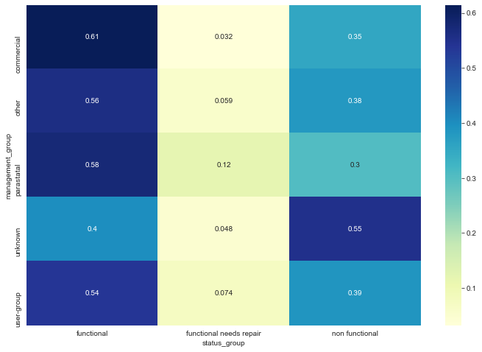
Feature Selection
Some features were related to each other
Correlation between the unique values of these features and label variable used to select features
Management vs. Management Group

Slide 7
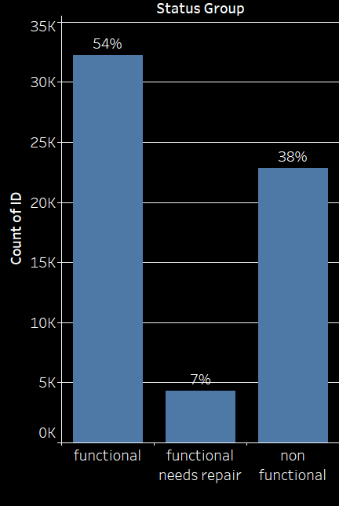
Imbalanced Data
Target Label had 3 levels of classification
Only 7% of the training dataset had the label "functional but needs repair“
Techniques like class_weight were used to improve prediction accuracy

Slide 8




Lessons Learned & Improvements
Typographical Error in Column
Un-Expected Algorithm performance
Lower Accuracy
Feature Engineering

Slide 9
Model Development
82%
Random Forest + OE
80.52%
XGBoost + OE
79.16%
Random Forest + GS
OE + Transformation Balanced Data 81.50%
Light GBM + OE
73.78%
XGBoost + RS
OE + Transformation
Balanced Data
79.27%
Catboost + OE
78.86%
Decision Tree
51.70%
GS: Grid Search OE: Ordinal Encoding RS: Random Search
50%

Slide 10
Financial Impact Analysis - Assumptions
Outcomes | Average Cost | Assumptions
Pump Replacement | $5,000 | For non-functional pumps
Pump Repair | $500 | For functioning pumps that will fail soon (damaged)
Major Economic Damage | $20,000 | Occurs if a non-functional pump is not replaced
Minor Economic Damage | $5,500 | Occurs if a damaged pump is not repaired

Slide 11
Financial Impact Analysis – Without Model
Do Nothing
Do not repair or replace any pumps
Prediction | Actual
 | Non-functional | Functional, but needs repairs | Functional
Nonfunctional | 0 | 0 | 0
Functional | 22,824 | 4,317 | 32,259
Prediction
 | Non-functional | Functional, but needs repairs | Functional
Nonfunctional | $0 | $0 | $0
Functional | $456,480,000 | $23,743,500 | $0
Total = $480,223,500
Random
Only repair or replace pumps installed in 1981
Prediction | Actual
 | Non-functional | Functional, but needs repairs | Functional
Nonfunctional | 142 | 11 | 85
Functional | 22,682 | 4,306 | 32,174
Prediction | Actual
 | Non-functional | Functional, but needs repairs | Functional
Nonfunctional | $710,000 | $55,000 | $425,000
Functional | $453,640,000 | $23,683,000 | $0
Total = $478,513,500

Slide 12
Financial Impact Analysis – With Model
Random Forest
Results in $443 million in savings, compared to cost of having no model
Prediction | Actual
 | Non-functional | Functional, but needs repairs | Functional
Nonfunctional | 3,595 | 95 | 882
Functional, but needs repairs | 121 | 312 | 418
Functional | 575 | 211 | 5,671
Prediction | Actual
 | Non-functional | Functional, but needs repairs | Functional
Nonfunctional | $17,975,000 | $475,000 | $4,410,000
Functional, but needs repairs | $665,500 | $156,000 | $209,000
Functional | $11,500,000 | $1,160,500 | $0
Total = $36,551,000
XG Boost
Results in $447 million in savings, driven by less false negatives
Prediction | Actual
 | Nonfunctional | Functional but needs repair soon | Functional
Nonfunctional | 2709 | 22 | 1760
Functional, but needs repairs | 132 | 92 | 627
Functional | 437 | 26 | 5994
Prediction | Actual
 | Non-functional | Functional, but needs repairs | Functional
Nonfunctional | $13,545,000 | $110,000 | $8,800,000
Functional, but needs repairs | $726,000 | $46,000 | $313,500
Functional | $8,740,000 | $143,000 | $0
Total = $32,423,500

Slide 13



Recommended Use Of Our Model
Identify which pumps are likely to fail soon and preemptively position resources nearby
Investigate causes of failure and research how to improve pump resilience
Reallocate funding and prioritize expanding water infrastructure to under-supplied communities

Slide 14
Questions?

Slide 15
Thank You

Slide 16
Appendix

Slide 17
Exhibit 1
Cross Validation | Precision | Recall | F1-score | Support
Functional | 0.81 | 0.88 | 0.84 | 6457
Functional needs repair | 0.50 | 0.37 | 0.42 | 851
Non functional | 0.84 | 0.79 | 0.81 | 4572
Accuracy |  |  | 0.81 | 11880
Marco avg | 0.72 | 0.68 | 0.69 | 11880
Weighted avg | 0.80 | 0.81 | 0.80 | 11880

Slide 18
Exhibit 2
Variable | Importance
longitude | 0.110340
latitude | 0.098175
quantity | 0.066009
wpt_name | 0.061691
subvillage | 0.061472
gps_height | 0.056436
ward | 0.051277
waterpoint_type | 0.041785
funder | 0.040297
popu_StdLog | 0.038927
extraction_type_class | 0.038212

Slide 19
Exhibit 3
Feature Engineering​ | Model​ | Score​
Imputed missing values, feature selection, Log transformation, Ordinal Encoding​ | Random Forest with Grid Search and balanced data​ | 0.8172​
Imputed missing values, feature selection, Log transformation, Ordinal Encoding​ | Random Forest with Grid Search​ | 0.8158​
Imputed missing values, feature selection, Log transformation, Ordinal Encoding, remove id​ | Random Forest with Grid Search and balanced data​ | 0.8150​
Imputed missing values, feature selection, Ordinal Encoding​ | Random Forest with Grid Search​ | 0.8129​
Imputed missing values, feature selection, Ordinal Encoding​ | Random Forest with Grid Search​ | 0.8110​
No FE, Random Select Features, Ordinal Encoding​ | Random Forest with Grid Search​ | 0.8075​
Imputed missing values, Include all features, Ordinal Encoding​ | Random Forest with Grid Search​ | 0.8067​
No FE, Random Select Features, Ordinal Encoding​ | Random Forest​ | 0.8052​
Imputed missing values, feature selection, Log transformation, Ordinal Encoding, remove id​ | Xgboost with Random Search​ | 0.7927​
Imputed missing values, feature selection, Ordinal Encoding​ | Xgboost​ | 0.7886​
No FE, Random Select Features, dummy variables​ | Decision Tree with Hyperparameter Tuning​ | 0.7779​
Imputed missing values, Include all features, Ordinal Encoding​ | LightGBM​ | 0.7776​
Imputed missing values, feature selection, Ordinal Encoding​ | Catboost​ | 0.7776​
No FE, Include all features, Ordinal Encordning​ | LightGBM​ | 0.7378​
No FE, Random Select Features, dummy variables​ | Decision Tree ​ | 0.5170​

